Slide 1
Intro to Statistics and R Programming
Lesson 1 - Fundamentals

Slide 2

What you will learn: Statistics
Sampling and data
Descriptive statistics
Distributions
Hypothesis testing
T-tests
ANOVA
Regression
Linear, multiple, logistic

Slide 3

What you will learn: R Programming
R Markdown
Data structures
Vectors, lists, matrices, and data frames
Exploratory analysis
Data transformation
Data visualization
Project management
Classes in R
Strings, factors, numerics, and datetimes
Model implementation

Slide 4

What is statistics?
Statistics is the science of collecting, analyzing, interpreting, and presenting data.
Two types:
Descriptive statistics summarizes the data
Distribution, central tendency, and variability
Inferential statistics infers properties of a population from samples
Hypothesis testing and regression analysis

Slide 5
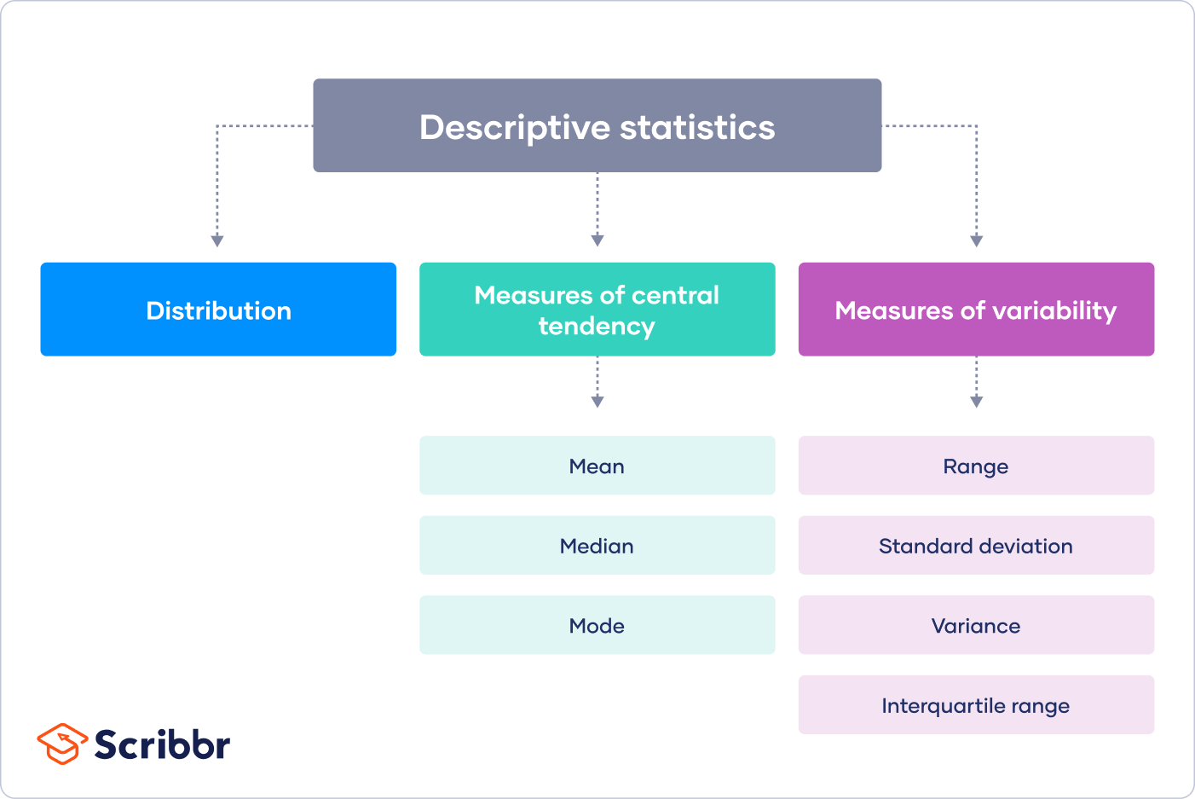
Descriptive statistics
Interquartile range = Q3 - Q1

Slide 6
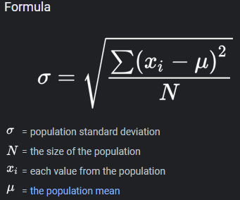
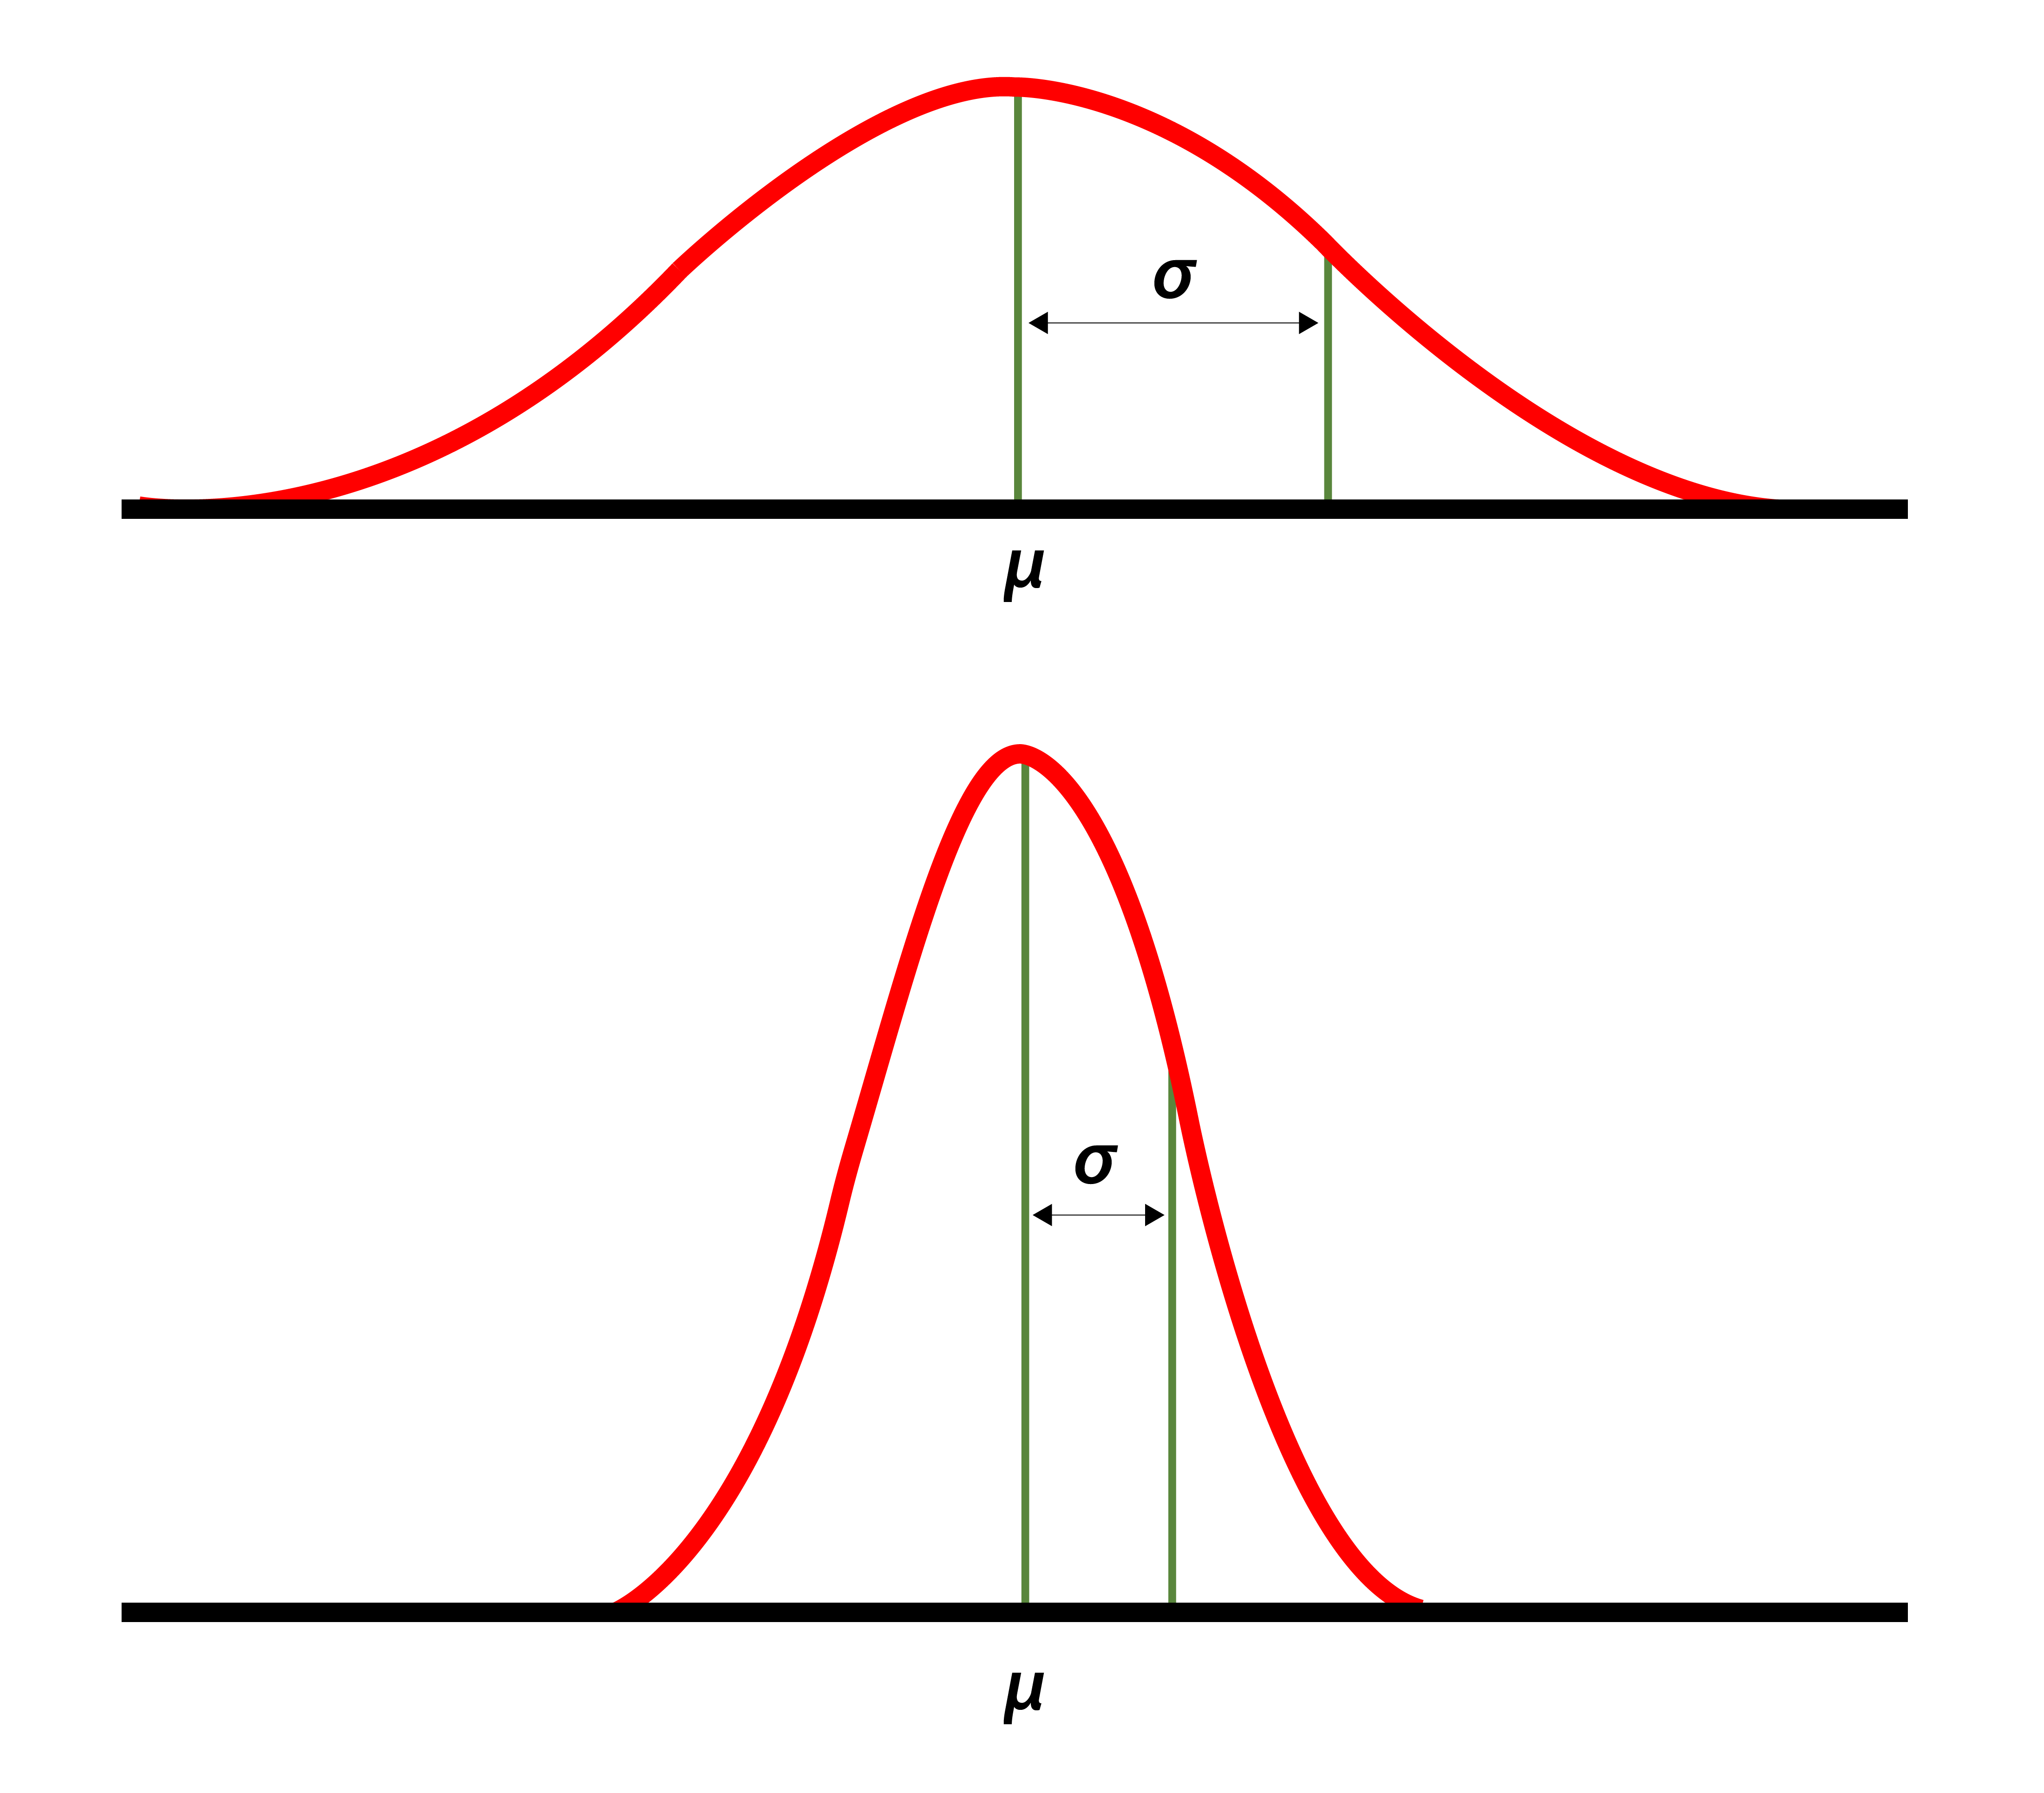
Descriptive statistics
Standard deviation measures the dispersion of data from the mean.
Variance is a measurement of spread between numbers in a data set.
Notes:
FOOTNOTE: give example, I will explain how we use these later on

Slide 7
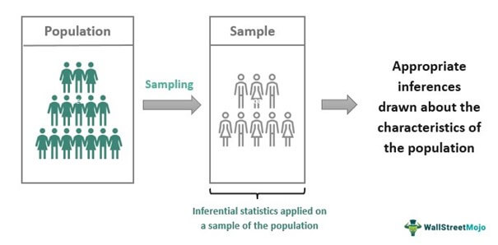
Inferential Statistics
A population is “a collection of persons, things, or objects under study.”
Samples are a subset of a population that is used to learn about the population they’re drawn from.
Notes:
“a collection of persons, things, or objects under study” (Introductory Statistics, Chapter 1, page 7)

Slide 8

Sampling replacement
Sampling with replacement means to return a member that is selected back into the pool
A sample taken without replacement does not return members back into the pool; once it is selected, it cannot be selected again

Slide 9
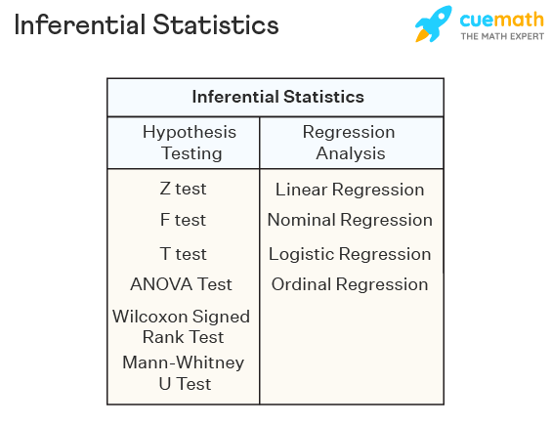
Inferential statistics
Notes:
The table lists tools used in performing inferential statistics

Slide 10
More key terms
Statistic – a number that represents the property of a sample
Parameter – a numerical characteristic of the whole population that can be estimated from a statistic
Variable – a characteristic or measurement that can be determined for each member of a population
Numeric/categorical
Data – the actual values of a variable
Notes:
Term definitions are pulled directly from the textbook (Introductory Statistics, Chapter 1, page 7)

Slide 11
Example!
We want to know the average (mean) amount of money first year college students spend at ABC College on school supplies that do not include books. We randomly surveyed 100 first year students at the college. Three of those students spent $150, $200, and $225, respectively.
Determine what the following key terms refer to in this study:
Population
Sample
Parameter
Statistic
Variable
Data
Notes:
Example 1.1 from the textbook (Introductory Statistics, Chapter 1, page 7-8)

Slide 12
Example!
The population is all first-year students attending ABC College this term
The sample could be all students enrolled in one section of a beginning statistics course at ABC College (although this sample may not represent the entire population)
The parameter is the average (mean) amount of money spent (excluding books) by first year college students at ABC College this term
The statistic is the average (mean) amount of money spent (excluding books) by first year college students in the sample
The variable could be the amount of money spent (excluding books) by one first year student. Let X = the amount of money spent (excluding books) by one first year student attending ABC College
The data are the dollar amounts spent by the first-year students. Examples of the data are $150, $200, and $225
Notes:
Solution 1.1 from the textbook (Introductory Statistics, Chapter 1, page 7-8)

Slide 13
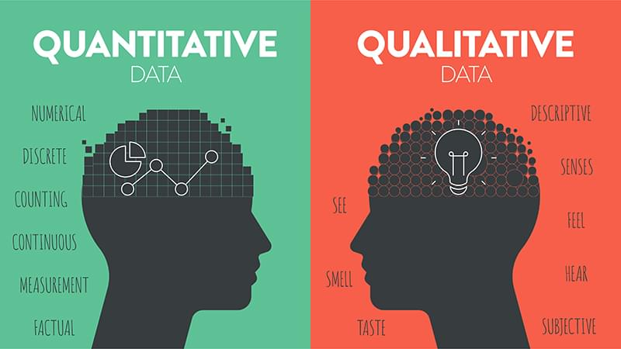
Qualitative vs quantitative data
Qualitative or categorical data are the result of categorizing or describing attributes of a population
Quantitative data are the result of counting or measuring attributes of a population
Notes:
Term definitions are pulled directly from the textbook (Introductory Statistics, Chapter 1, page 10)

Slide 14
Ordinal and nominal (qualitative)
Ordinal data are that which can be ranked from high to low
Examples: education, literacy level, socioeconomic status
Nominal data has no intrinsic rank
Examples: gender, race, nationality

Slide 15
Discrete and continuous (quantitative)
Discrete data can be counted and has a limited number of values
Examples: students in a class, tickets sold, teachers at a school
Continuous data can take on any value
Examples: temperature, proportion of fixations, test scores

Slide 16

Example!
You go to the supermarket and purchase three cans of soup (19 ounces tomato bisque, 14.1 ounces lentil, and 19 ounces Italian wedding), two packages of nuts (walnuts and peanuts), four different kinds of vegetable (broccoli, cauliflower, spinach, and carrots), and two desserts (16 ounces pistachio ice cream and 32 ounces chocolate chip cookies).
Name data sets that are quantitative discrete, quantitative continuous, and qualitative.
Notes:
Example 1.7 from the textbook (Introductory Statistics, Chapter 1, page 11)

Slide 17
Example!
One Possible Solution:
The three cans of soup, two packages of nuts, four kinds of vegetables and two desserts are quantitative discrete data because you count them
The weights of the soups (19 ounces, 14.1 ounces, 19 ounces) are quantitative continuous data because you measure weights as precisely as possible
Types of soups, nuts, vegetables and desserts are qualitative data because they are categorical
Notes:
Solution 1.7 from the textbook (Introductory Statistics, Chapter 1, page 11)

